Slide 1
Improving Cost and Schedule Performance on Large Energy Infrastructure Deployment Projects: Establishment of Best Practices for Risk Management and Organizational Learning in Nuclear Projects Post-Fukushima
Sola M. Talabi Ph.D., MBA, M.Sc., RMP
Carnegie Mellon University
Westinghouse Electric Co.

Slide 2
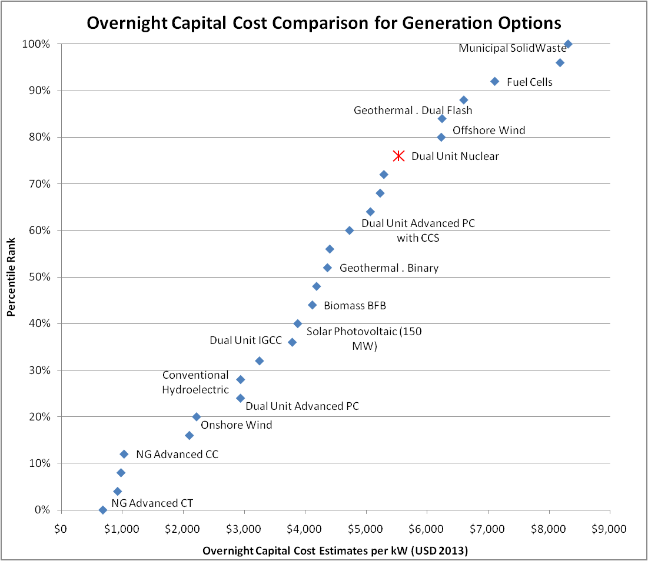
Significance of research on nuclear infrastructure deployment issues: Nuclear power construction overnight cost is amongst the highest and ranks in the top 25th percentile of costs
Source US-DOE (EIA, 2013)

Slide 3
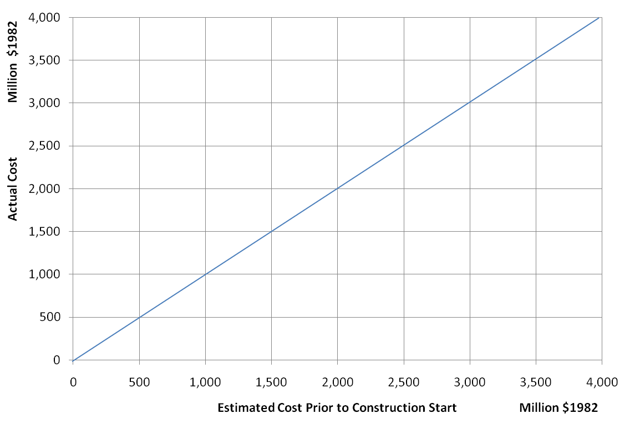
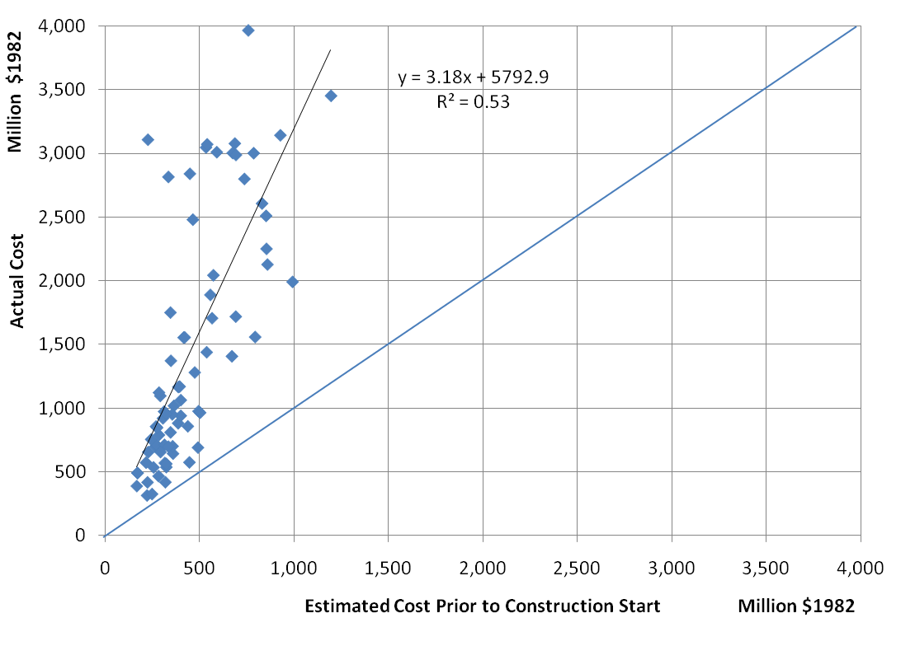
Nuclear power cost estimation and realized costs have performed below expectations
Nuclear power plant construction cost comparison of planned to actual costs, for plants with construction start dates from 1970 to 1984, source: (EIA, 1986)

Slide 4
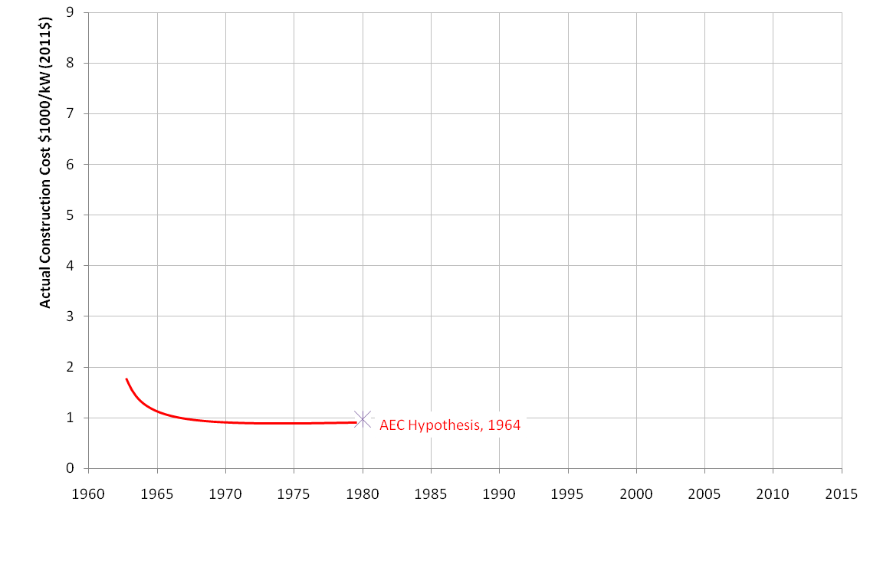
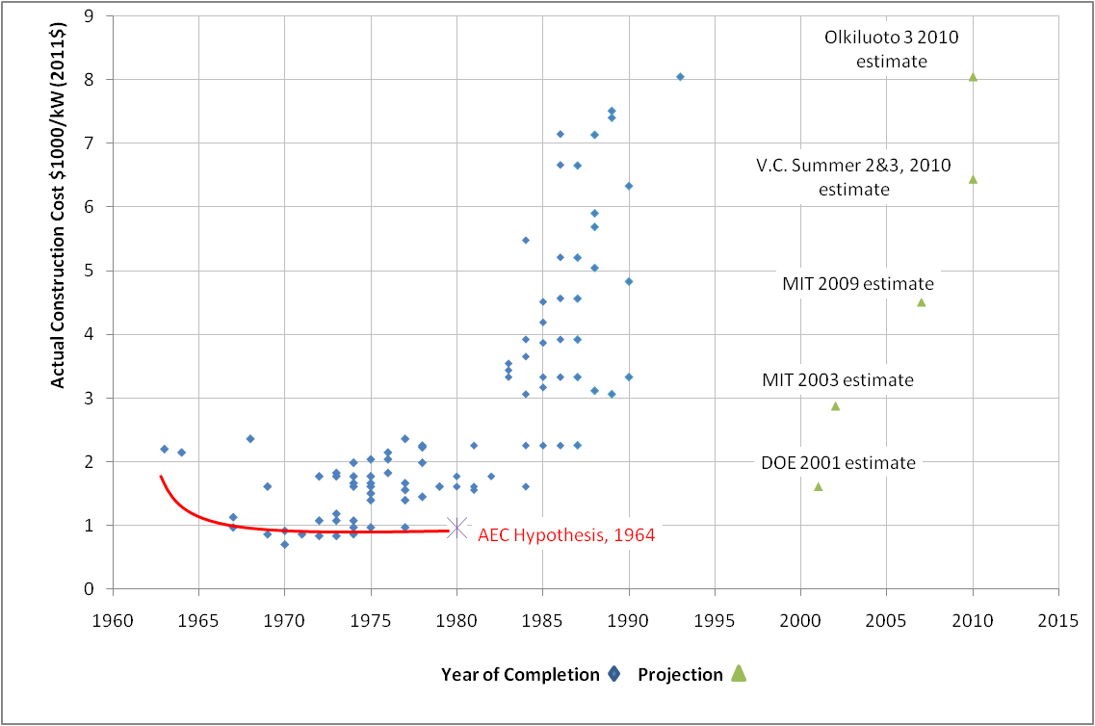
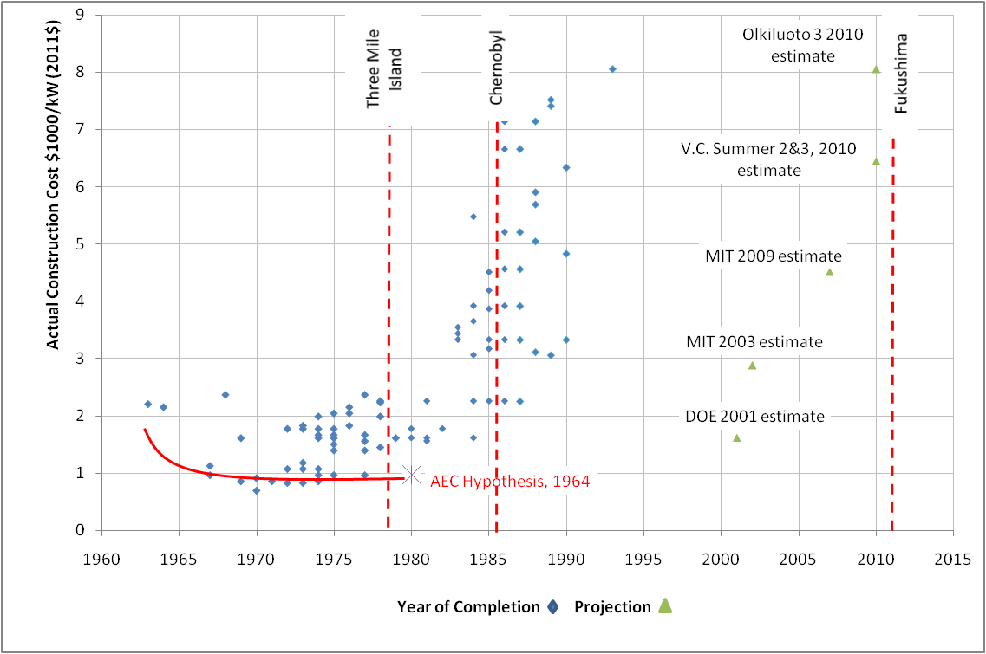
Nuclear power construction costs have increased contrary to expected reductions based on hypothesized learning

Slide 5
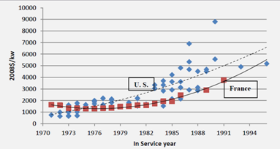
Although regulatory issues are significant, there are other compounding risk factors that need to be identified and better understood
Source: Cooper, M. Policy Challenges of Nuclear Power Construction
Comparison of French reactor cost to US reactors shows that even we control for design variability and regulatory uncertainty, cost increases persist

Slide 6
Several studies performed to understand causes of poor cost and schedule performance for nuclear plant construction
 | RAND Corp (1981) | EIA (DOE) (1986) | MIT (2003) | KPMG (2011) | Others
Regulatory Uncertainty | Cited as major factor | Cited | Cited | Cited | Cited
FOAK / Design Specification | Cited | Cited | Cited | Cited | Cited
Supply Chain Variability and Certainty | Cited | Cited | Cited | Cited as primary factor | Cited
Cost Estimation | Cited | Cited | Not Cited | Not Cited | Cited
Risk Management | Not cited | Cited | Not Cited | Cited | Cited
Risk Management?
All cited causes are related to risk management

Slide 7
Major advancements have been made in most areas, but limited in risk management
Regulatory Uncertainty | Design Issues/ FOAK / Changes | Supply Chain Variability and Certainty | Cost Estimation | Risk Management
Early Site Permitting | Utilities allowed to use more commercial grade materials | EPRI sponsored supply chain development programs | IAEA standard for cost estimation (Does not include risk assessment) | PMI, Other standards (not specific to mega-projects)
Combined construction and operating licenses (10CFR part52) | Reclassification of components as non-safety (10CFR50.69) | DOE investment in advanced manufacturing methods | Vendor specific initiatives | Advanced tools; @Risk, ARM, Crystal Ball etc.
Significantly limited role for public in hearing process | 3-Dimensional modeling | Increased international capacity development – Doosan, JSW, ENSA, Mangiarotti
NRC pre-approval of standardized plant designs | Modular | Advanced computerized manufacturing
Cost and schedule overruns persist in spite of these initiatives:
Olkiluoto 3 – 7 year delay
V.C. Summer 2 & 3 1 year delay, $300 million over budget
Vogtle - $900 million over budget
Watts Bar Unit 2 - $2billion over budget
Objective of Research:
*Fill the void in risk related advancement
*Create an organized approach to improve risk identification and risk assessment

Slide 8
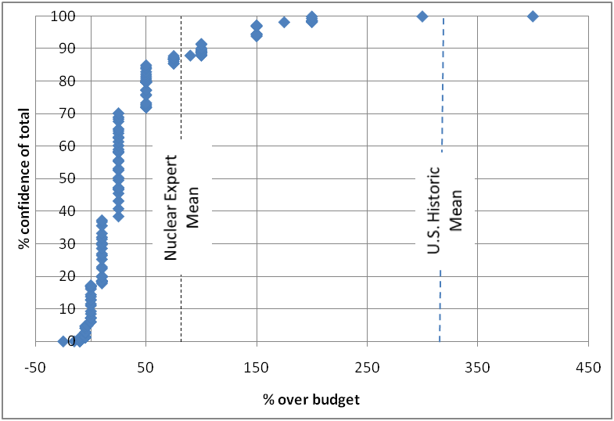
Experts believe that significant overruns may occur, but less than historical mean
U.S. Historical Mean
Experts expect a mean cost overrun of 85%

Slide 9
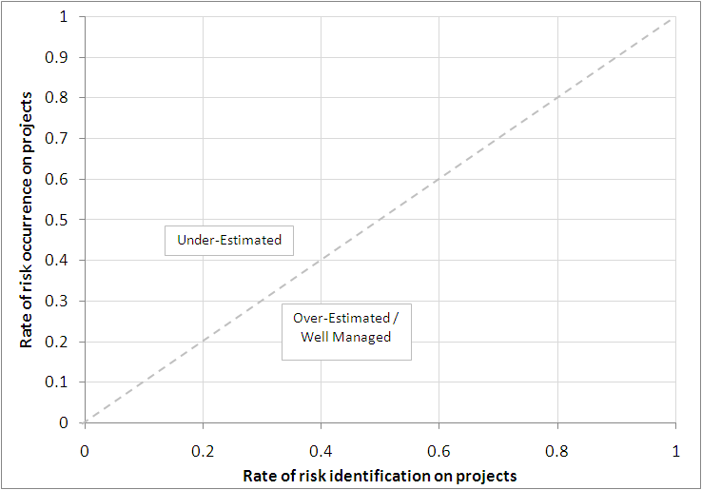
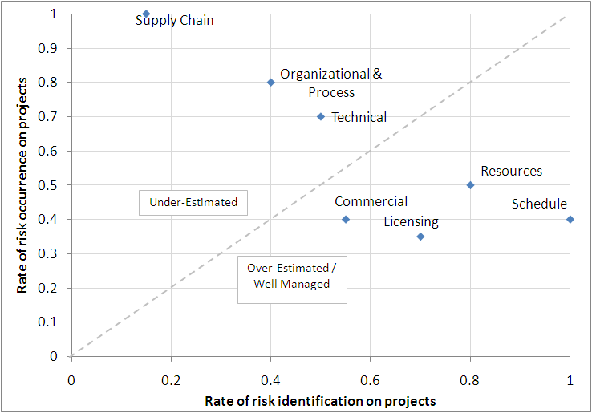
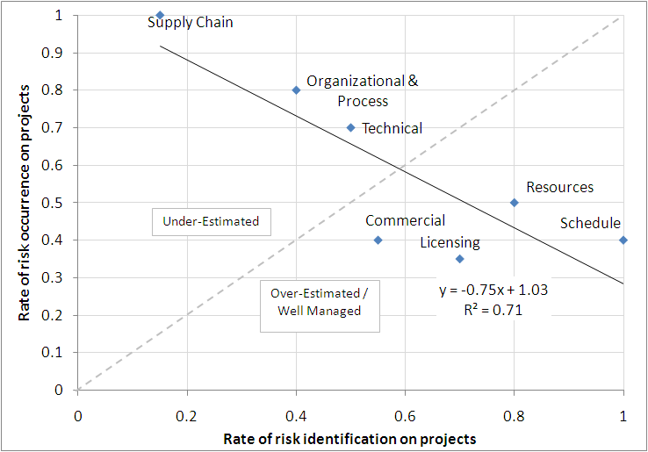
An association exists between the rate of risk identification and risk occurrence on nuclear projects
Technical risks documented on 70% of projects
Technical risks identified on 50% of projects

Slide 10
Estimation errors exist with probability and impact estimation
 |  | Estimated Impact ($1,000)
 | 5.71 | 1 | 10 | 20 | 30 | 40 | 50 | 60 | 70 | 80 | 90 | 100
Assessed Probability | 0.01 | 6.3 | 6.2 | 6.2 | 6.2 | 6.1 | 6.1 | 6.1 | 6.1 | 6.0 | 6.0 | 6.0
 | 0.10 | 6.0 | 5.9 | 5.9 | 5.9 | 5.9 | 5.8 | 5.8 | 5.8 | 5.8 | 5.7 | 5.7
 | 0.20 | 5.7 | 5.6 | 5.6 | 5.6 | 5.6 | 5.5 | 5.5 | 5.5 | 5.5 | 5.4 | 5.4
 | 0.30 | 5.3 | 5.3 | 5.3 | 5.3 | 5.2 | 5.2 | 5.2 | 5.2 | 5.2 | 5.1 | 5.1
 | 0.40 | 5.0 | 5.0 | 5.0 | 5.0 | 4.9 | 4.9 | 4.9 | 4.9 | 4.8 | 4.8 | 4.8
 | 0.50 | 4.7 | 4.7 | 4.7 | 4.7 | 4.6 | 4.6 | 4.6 | 4.6 | 4.5 | 4.5 | 4.5
 | 0.60 | 4.4 | 4.4 | 4.4 | 4.3 | 4.3 | 4.3 | 4.3 | 4.3 | 4.2 | 4.2 | 4.2
 | 0.70 | 4.1 | 4.1 | 4.0 | 4.0 | 4.0 | 4.0 | 4.0 | 4.0 | 3.9 | 3.9 | 3.9
 | 0.80 | 3.8 | 3.8 | 3.7 | 3.7 | 3.7 | 3.7 | 3.7 | 3.7 | 3.6 | 3.6 | 3.6
 | 0.90 | 3.5 | 3.4 | 3.4 | 3.4 | 3.4 | 3.4 | 3.4 | 3.3 | 3.3 | 3.3 | 3.3
 | 1.00 | 3.1 | 3.1 | 3.1 | 3.1 | 3.1 | 3.1 | 3.1 | 3.0 | 3.0 | 3.0 | 3.0
 | Probability | Impact
Assessed | 0.1 | $100,000
Correction | 5.7

Slide 11
Understanding the causes of an absence of learning in historical nuclear power construction cost
Statistical analysis of historical nuclear power construction data including:
Estimated and realized costs
Estimated and realized lead-times (schedule)
Plant size
Constructor information
Sample of plants in dataset:
67 non-turnkey US projects, hence overruns reported by utility
Start dates between 1966 – 1977, completion by 1986
Source: “An Analysis of Nuclear Power Plant Construction Costs” (EIA, report in1986)

Slide 12
Background: Nuclear power construction costs have increased contrary to expected reductions based on hypothesized learning
AEC’s assumptions for learning:
Economies of scale, assumed up to 3000MWe plants would be built, and 20% cost reduction from 1000MWe to 3000MWe
Constructor experience
Tradeoff between cost and schedule performance

Slide 13
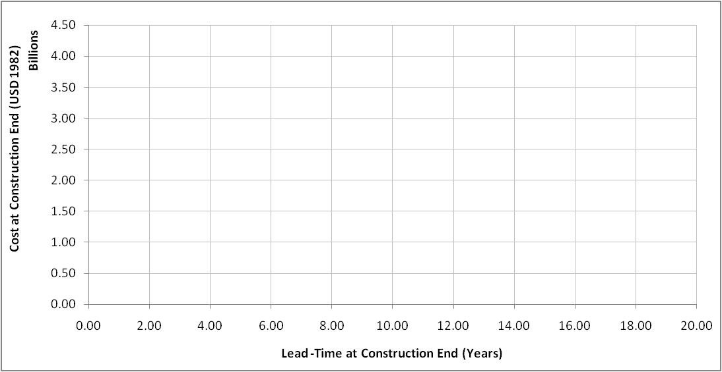
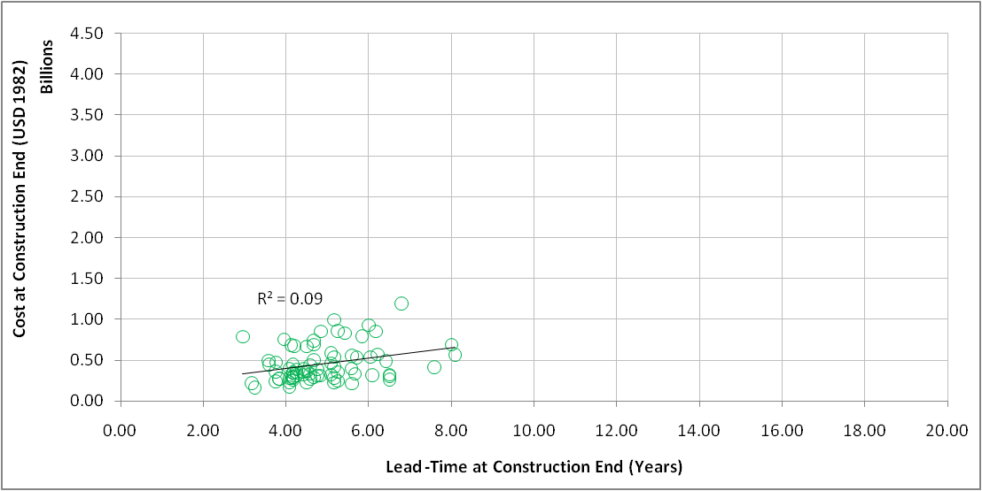
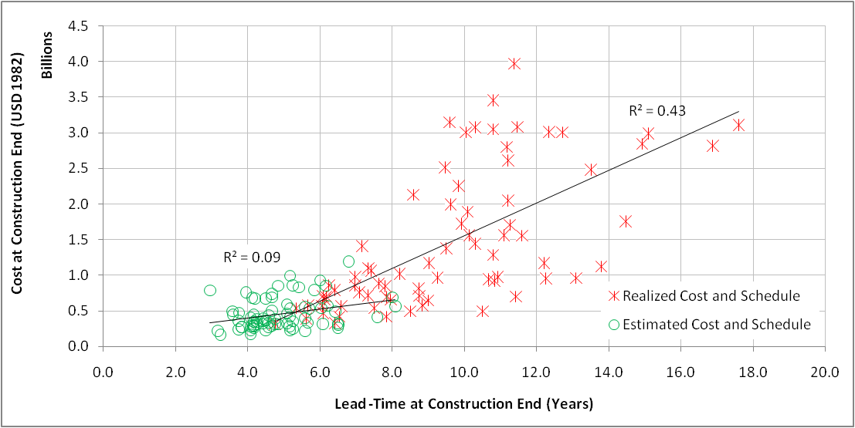
What role did estimation play in historical cost overruns?
A relationship existed between cost and lead-times that was not reflected in estimates

Slide 14
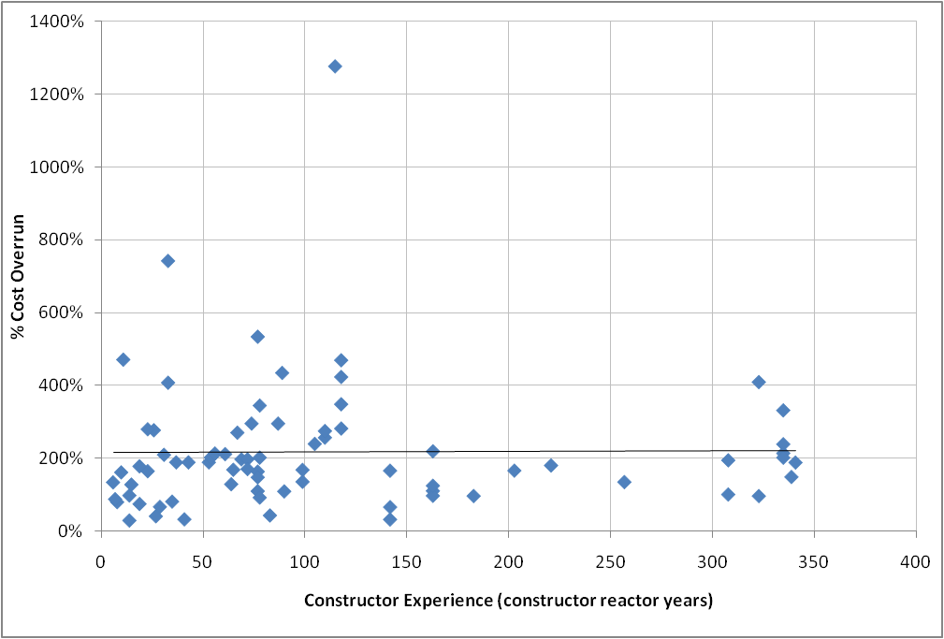
Validating assumptions of learning based on constructor experience (cost overrun review)
Experience is defined in EIA report as:
“the number of reactors under construction or completed, multiplied by the number of years during which such activity took place.”
No evidence of association between experience and cost overruns

Slide 15
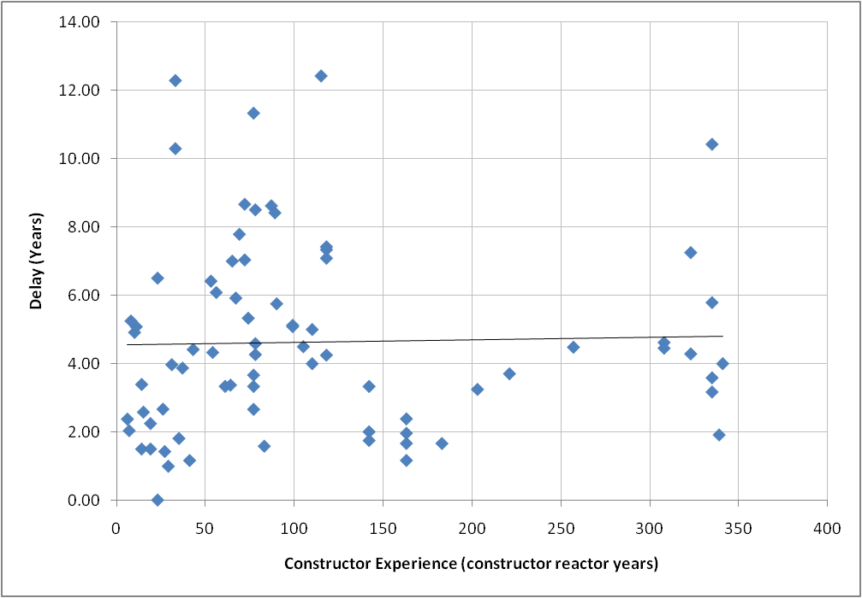
Validating assumptions of learning based on constructor experience (schedule delay review)
Experience is defined in EIA report as:
“the number of reactors under construction or completed, multiplied by the number of years during which such activity took place.”
No evidence of association between experience and schedule delays

Slide 16
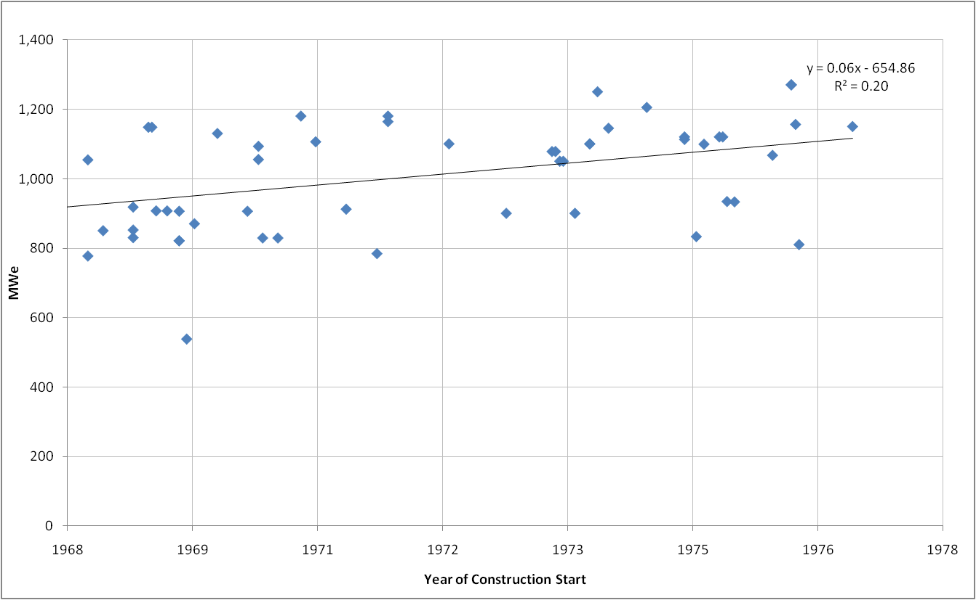
Validating assumptions of economies of scale: Review of plant size over time
To understand effect of size on cost:
Review of plant size trend over time
Plant size increased over time

Slide 17
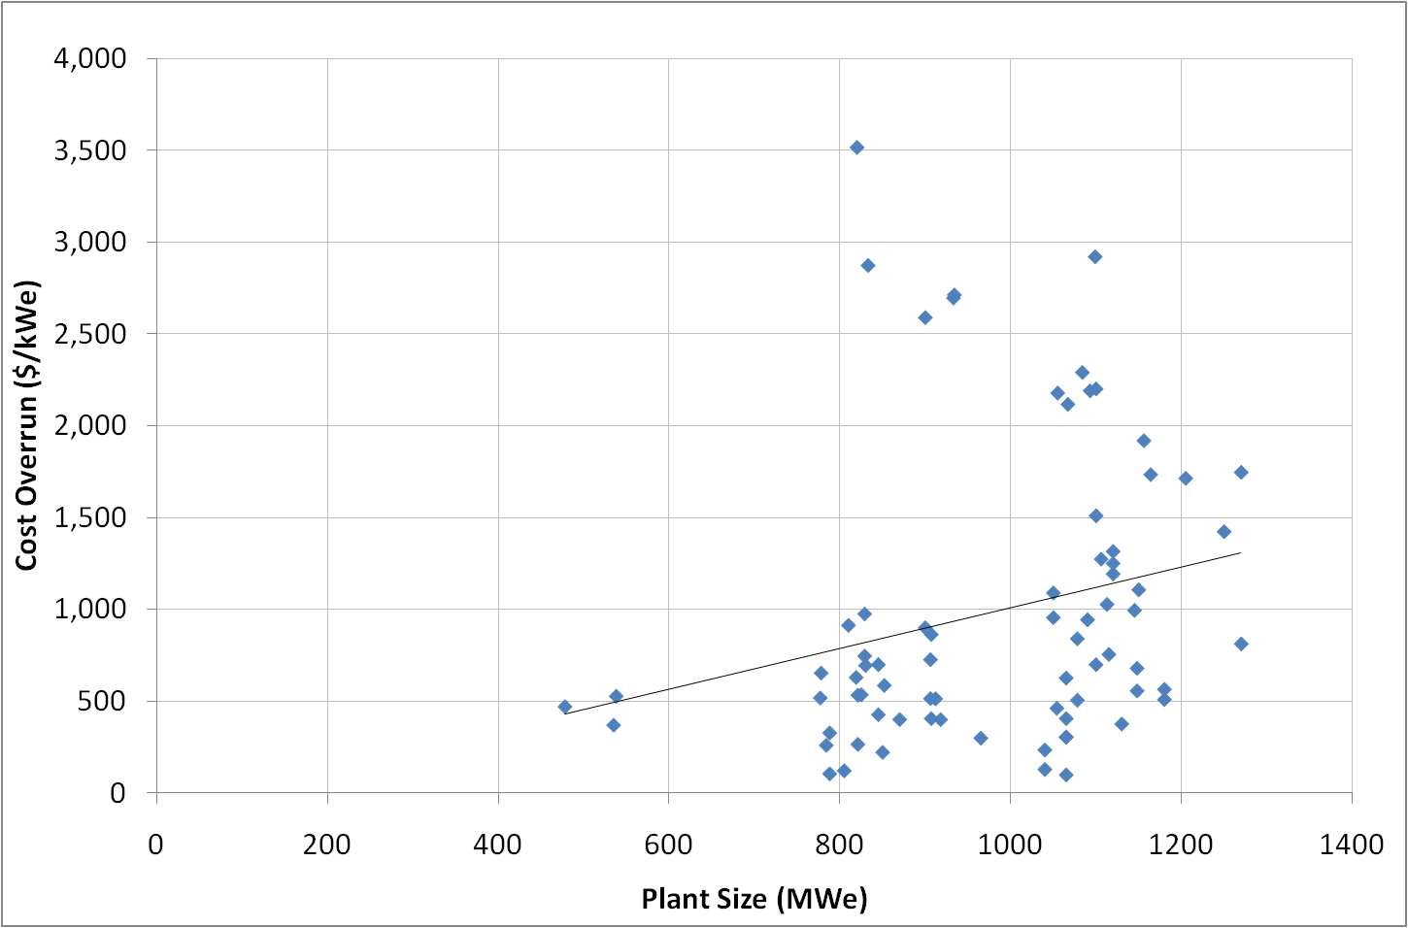
Validating assumptions of economies of scale: Review of plant size and cost overruns
To understand effect of size on cost:
Review of plant size and cost overruns
Data are not negatively correlated
Cost increases as size increases

Slide 18
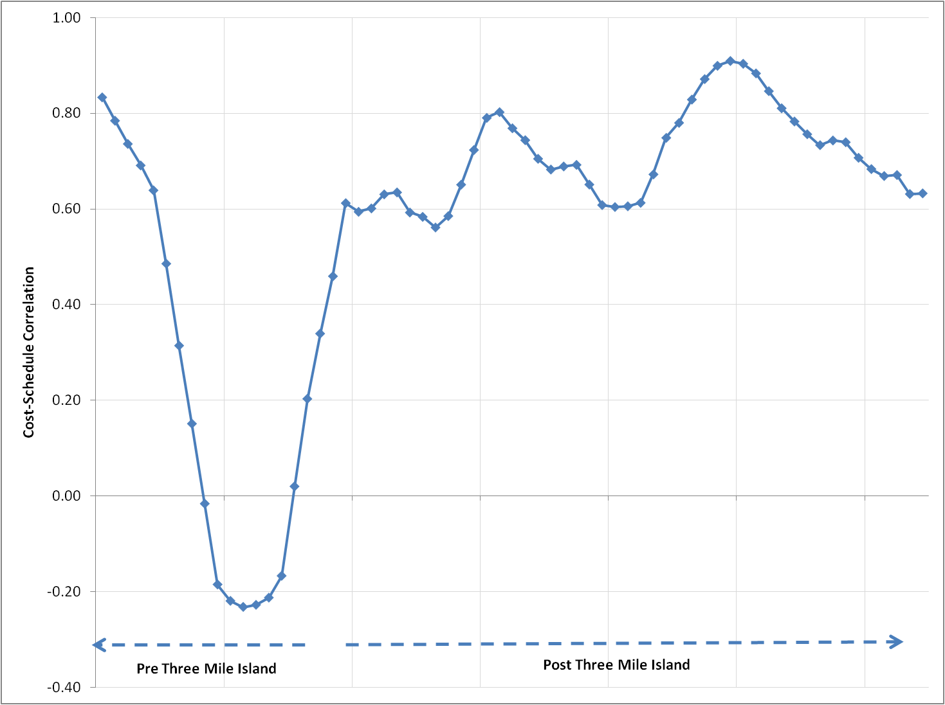
Validating assumptions of tradeoffs between cost and schedule performance
To explore potential tradeoffs between cost and lead-times:
Plot of correlation between cost overruns and schedule delay
Results:
Only evidence of tradeoff occurred briefly in mid 1970s, and ceased after TMI

Slide 19
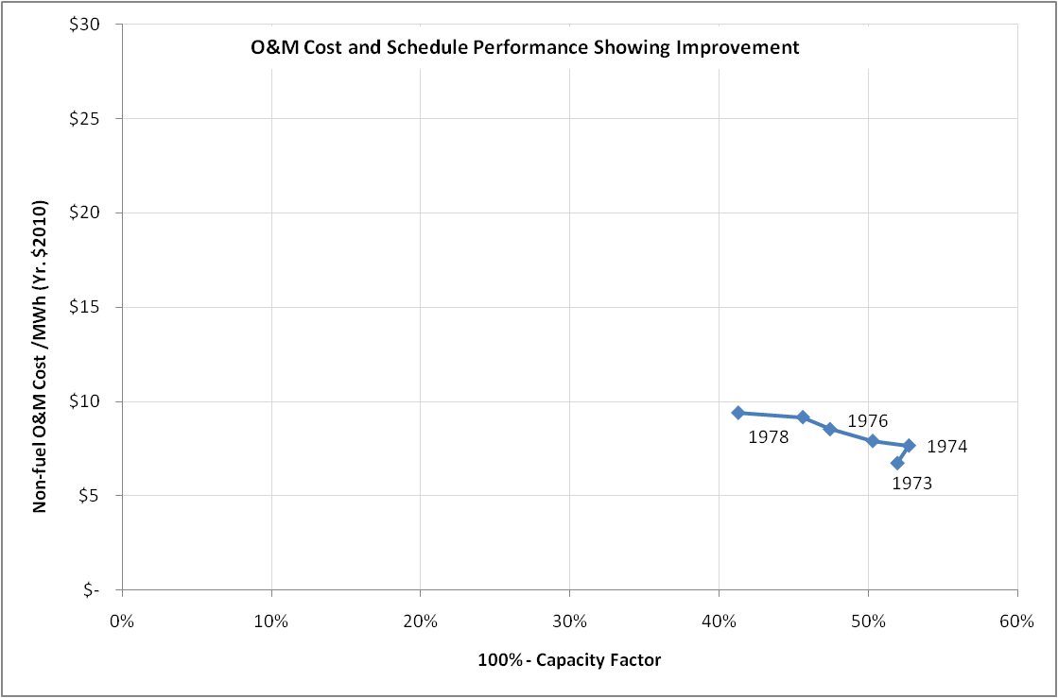
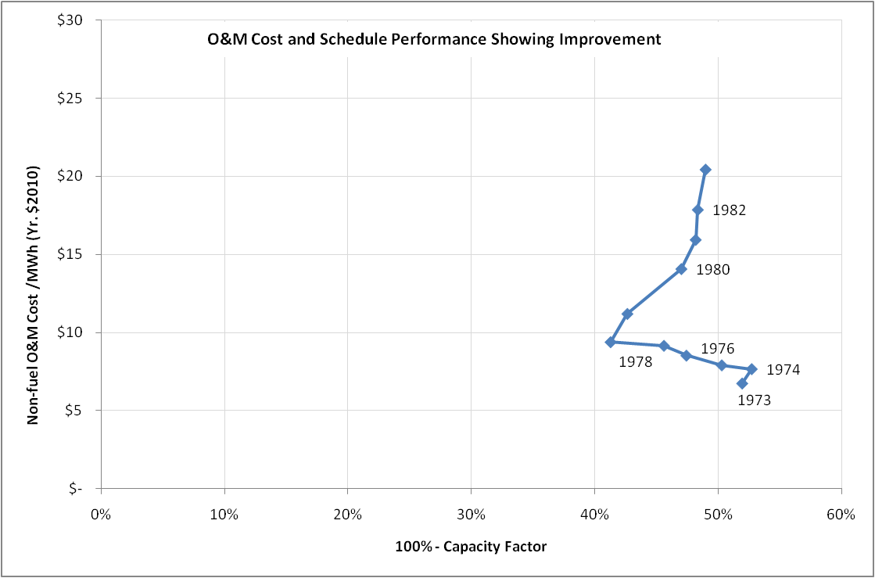
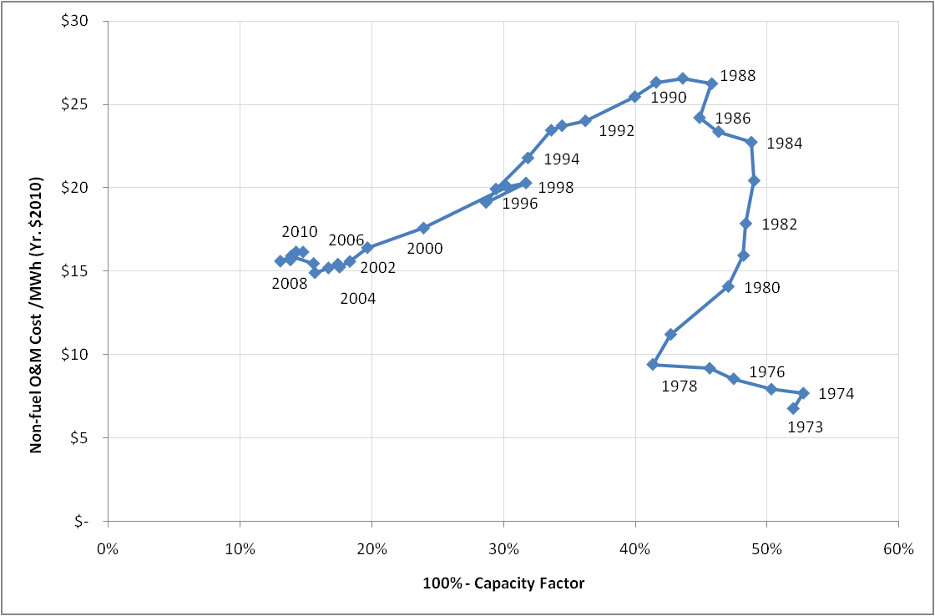
Identifying methods to introduce industry-wide learning based on a comparison with nuclear power operations and maintenance practices: Review of O&M costs
No-Learning
Learning
No-Learning
TMI
TMI
TMI

Slide 20
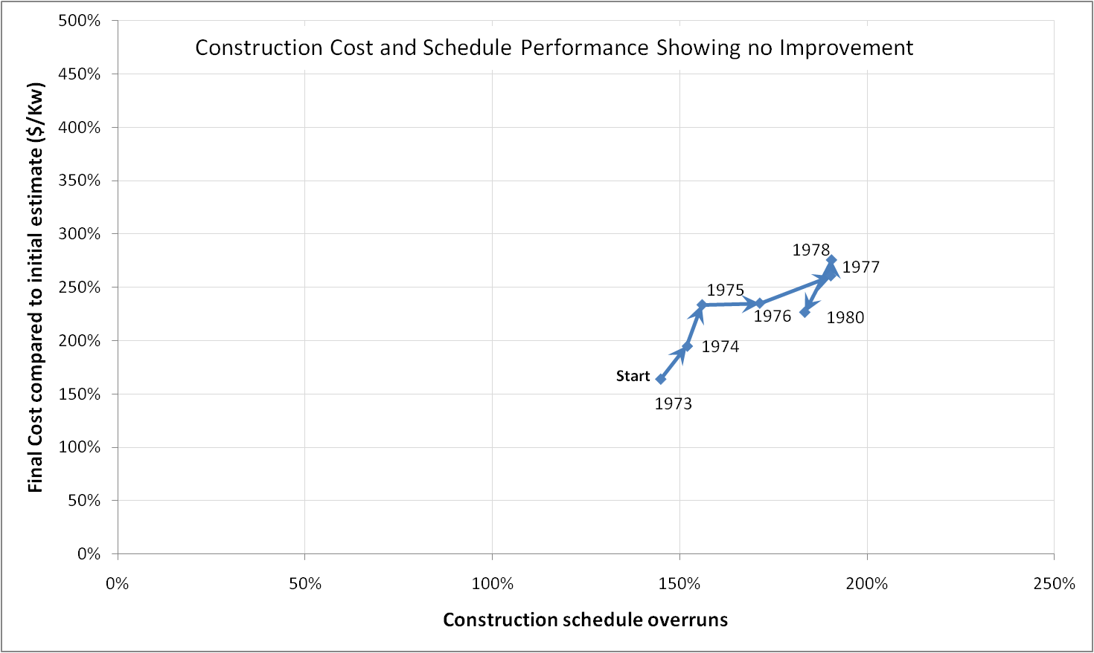
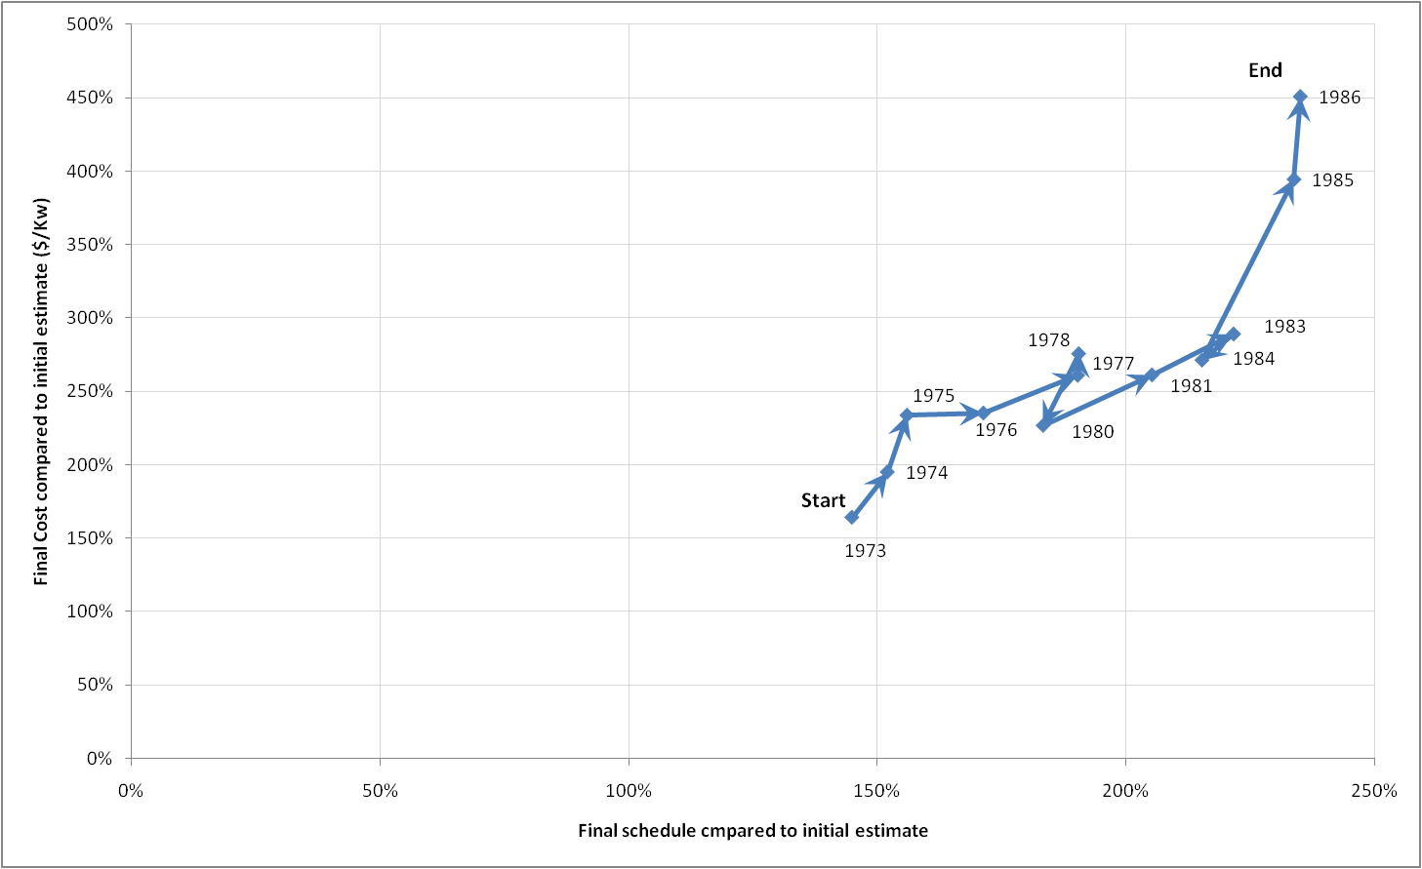
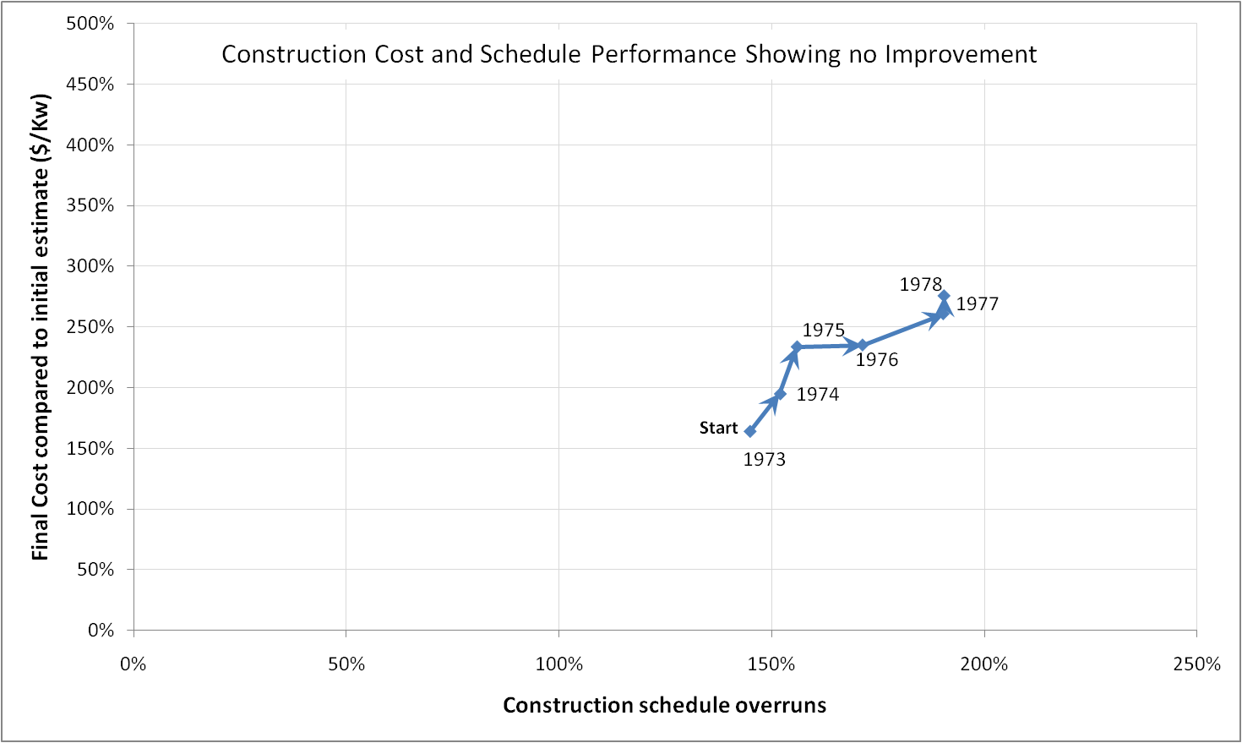
Identifying methods to introduce industry-wide learning based on a comparison with nuclear power operations and maintenance practices: Review of construction costs
No-Learning
No-Learning
Learning?

Slide 21
Comparison of performance curves for O&M and construction

Slide 22
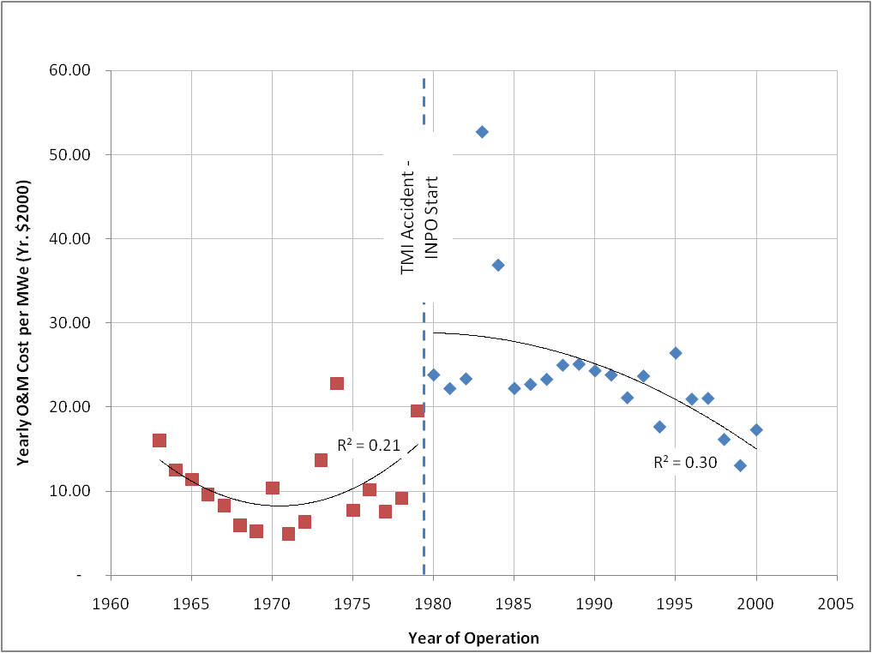
Association between start of INPO and reduction in rate of cost increase
INPO: Institute for Nuclear Power Operations
Started in Dec. 1979 as recommendation from Kemeney commission in response to Three-Mile Island accident
Objectives include improving safety and operational performance
Plant evaluations
Training and accreditation
Events analysis and information exchange
Utility technical and management assistance

Slide 23
Policy Implications
There is much disagreement with the assessment of risks associated with nuclear power plant EPC projects. Sovereign support requires objective risk assessments:
Constellation Energy cancelled Calvert Cliffs Unit 3 nuclear power plant project because OMB calculated higher than expected risk evaluation
President of the Nuclear Energy Institute issued a press release stating: “… the formula used by the DOE and OMB to determine the (risk associated with building the plant) is seriously flawed”.
This study provides insights into issues with the methods and practices of risk and cost uncertainty management in nuclear power EPC projects.
Establishes the need for improved and standardized methods of risk and uncertainty analysis for nuclear power EPC projects
Identifies specific opportunities and strategies to improve and advance the practice of risk management in nuclear power plant EPC projects.
For nuclear energy to be competitive, a dedicated effort such as INPO could provide a collective organized learning protocol to capture improvements in plant construction

Slide 24
Summary of findings
Inadequacies in the performance of risk management has contributed to historical under performance of nuclear deployment projects
There is evidence of learning in nuclear power operations and maintenance.
Association exists between nuclear power operations and maintenance cost performance improvements and the commencement of INPO’s operations
An industry-wide approach similar to INPO may improve construction cost and schedule performance
The results of this study has led to the initiation of an industry-wide effort to establish a standard of practice for risk management through EPRI

Slide 25
Outcomes: Establishment of a Center to Improve Project Cost and Schedule Delivery for Large Energy Infrastructure Projects
IDEAL: Infrastructure Deployment Efficiency and Learning
Objective: Improve energy infrastructure project delivery performance through research on industry-recommended development and deployment issues
Initial project: Develop a risk management standard of practice for large infrastructure projects funded by EPRI
Industry participants include stakeholders presently building plants:
Vendors:
Westinghouse Electric Co.
GE-Hitachi
Utilities:
Tennessee Valley Authority
Southern Co.
Duke Energy

